Slide 1
Randomized Algorithms CS648
Lecture 3
Algebraic Techniques (Frievald’s Technique)
Two interesting problems

Slide 2
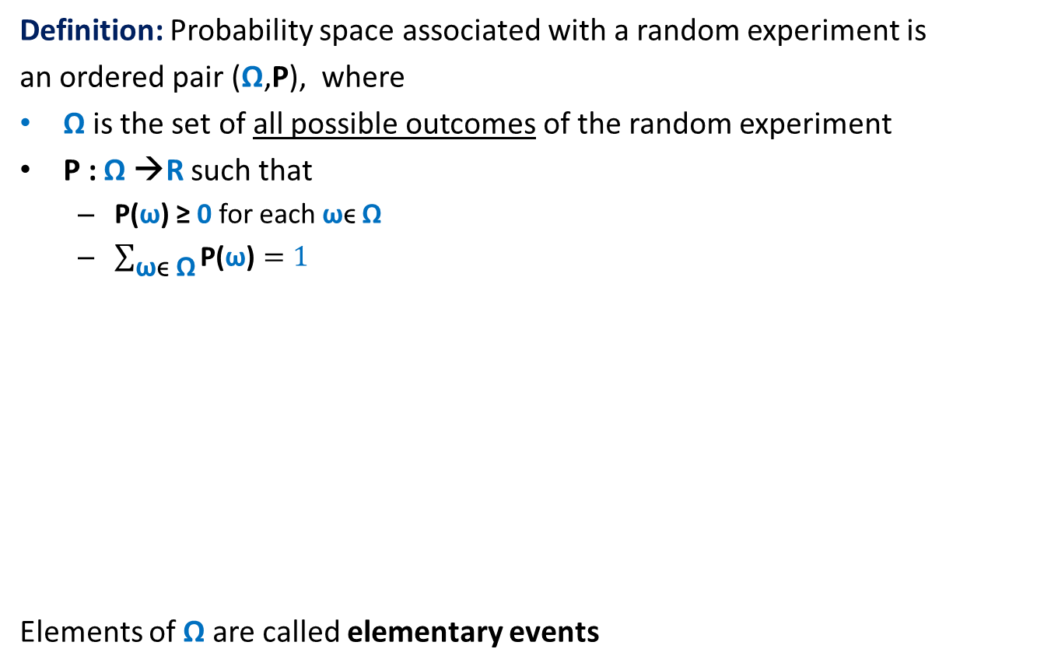
Probability Space
Definition: Probability space associated with a random experiment is
an ordered pair (Ω,P), where
Ω is the set of all possible outcomes of the random experiment
P : Ω →R such that
P(ω) ≥ 0 for each ωϵ Ω
$\sum_{\text{ω}\text{ϵ} \text{Ω}}{\text{P}\text{(}\text{ω}\text{)}}=1$
Elements of Ω are called elementary events
Ω
or sample points.

Slide 3


Event in a Probability Space
Definition: An event A in a probability space (Ω,P) is a subset of Ω.
The probability of event A is defined as
$$\sum_{\text{ω}\text{ϵ} \text{A}}{\text{P}\text{(}\text{ω}\text{)}}$$
For sake of compact notation, we extend P for events as described above.
$\text{P}\text{(}\text{A}\text{)}$ =
A
Ω

Slide 4
Fundamental Concepts
Probability of
Union of events
Intersection of events
Conditional Probability
Independent events
Disjoint events
Make sure you have clear understanding of these concepts.
You may consult the slides “Elementary-Probability-Theory”
posted on the course website OR meet me for any query.

Slide 5









A Powerful tool Partition of sample space
A set of events $A_{1}$,…, $A_{n}$defined over a probability space ($Ω$,P)
is said to induce a partition of $Ω$ if
$\bigcup_{l=1}^{n}{A_{l}}$ = $Ω$
$A_{i}\bigcap{A_{j}}$ =∅ for all$i≠j$
Theorem: (Partition theorem)
Given an event $ε$, we can express P($ε$) in terms of a given partition as:
P($ε$) = $\sum_{l}{\text{P}\text{(}ε}∩A_{l}$)
= $\sum_{l}{\text{P}\text{(}ε}\text{|}A_{l}$)∙ $\text{P}\text{(}A_{l}\text{)}$ using conditional probability
$≤$ $α$ $\sum_{l}{\text{P}\text{(}A_{l}\text{)}}$
$=$ $α⋅1$
$$A_{2}$$
$$A_{3}$$
$$A_{4}$$
$$ε$$
$$A_{5}$$
$$A_{1}$$
Ω
$$A_{6}$$
$$≤α$$

Slide 6
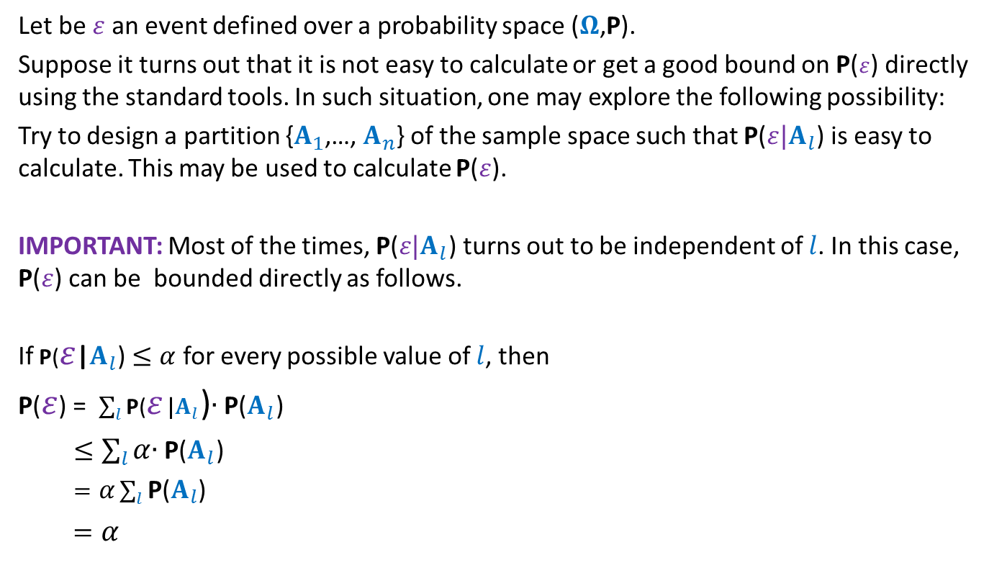
Question: When to use the Partition theorem ?
Let be $ε$an event defined over a probability space ($Ω$,P).
Suppose it turns out that it is not easy to calculate or get a good bound on P($ε$) directly using the standard tools. In such situation, one may explore the following possibility:
Try to design a partition {$A_{1}$,…, $A_{n}$} of the sample space such that $\text{P}\text{(}ε|A_{l}$) is easy to calculate. This may be used to calculate $\text{P}\text{(}ε$).
IMPORTANT: Most of the times, $\text{P}\text{(}ε|A_{l}$) turns out to be independent of $l$. In this case, $\text{P}\text{(}ε$) can be bounded directly as follows.
If $\text{P}\text{(}ε$|$A_{l}$) $≤α$ for every possible value of $l$, then
P($ε$) = $\sum_{l}{\text{P}\text{(}ε}\text{|}A_{l}$)∙ $\text{P}\text{(}A_{l}\text{)}$
$≤\sum_{l}{α}$∙ $\text{P}\text{(}A_{l}\text{)}$
$=α\sum_{l}{\text{P}\text{(}A_{l}\text{) }}$
$=α$

Slide 7
Frievald’s technique
Application : Matrix Product verification

Slide 8






Matrix Product Verification
No
Is $A×B$ = $B×A$ ?
Is $\left(A×B\right)×C$ = $A×(B×C)$ ?
Matrix product is non-commutative.
Matrix product is associative.
Yes
$$1 2 … n$$
$$1$$
2
$$⋮$$
$$n$$
$$⨯$$
$$A$$
$$B$$

Slide 9








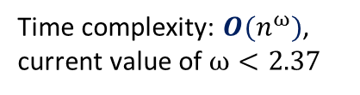


Frievald’s Algorithm
Matrix Product Verification
(Rusins Frievald, $1977$)
Problem: Given three $n$-by-$n$matrices $A$, $B$, and $C$, determine if $C≟A⨯B$.
Best deterministic algorithm:
$D$ ← $A⨯B$;
Verify if $C=D$ ?
$$1 2 … n$$
$$1$$
2
$$⋮$$
$$n$$
$$≟$$
$$⨯$$
$$C$$
$$A$$
$$B$$
Time complexity: $O(n^{ω})$,
current value of $ω<2.37$
STOC $2012$

Slide 10















Frievald’s Algorithm
$O\left(n^{ω}\right)$ time
$$1$$
0
$$⋮$$
$$1$$
$$1$$
0
$$⨯$$
$$⨯$$
$$A$$
$$B$$
$$x$$
$$y$$
$$≟$$
$$1$$
0
$$⋮$$
$$1$$
$$1$$
0
$$⨯$$
$O\left(n^{2}\right)$ time
$$C$$
$$x$$
$$z$$

Slide 11


Frievald’s Algorithm
$O\left(n^{2}\right)$ time
(Rusins Frievald, $1977$)
$O\left(n^{ω}\right)$ time
$$1$$
0
$$⋮$$
$$1$$
$$1$$
0
$$⨯$$
$$⨯$$
$$A$$
$$B$$
$$x$$
$$y$$
$$≟$$
$$1$$
0
$$⋮$$
$$1$$
$$1$$
0
$$⨯$$
$O\left(n^{2}\right)$ time
$$C$$
$$x$$
$$z$$
Matrix product is associative. ☺

Slide 12

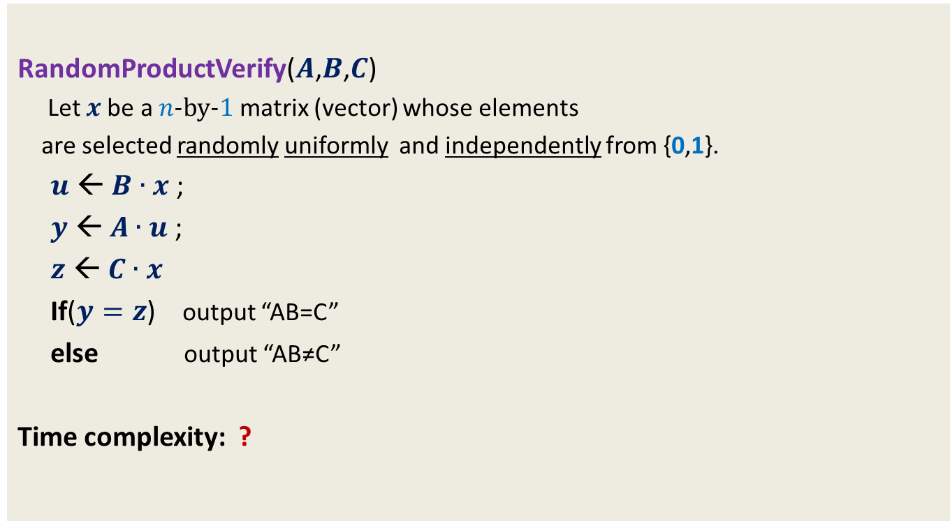
Frievald’s Algorithm
(Rusins Frievald, $1977$)
RandomProductVerify($A$,$B$,$C$)
Let $x$be a $n$-by-$1$matrix (vector) whose elements
are selected randomly uniformly and independently from {0,1}.
$u$ ← $B∙x$ ;
$y$ ← $A∙u$ ;
$z$ ← $C∙x$
If($y=z$) output “AB=C”
else output “AB≠C”
Time complexity: ?
$$O(n^{2})$$

Slide 13





Error Analysis
Cases
$$A∙B=C$$
No error
$$A∙B∙x=C∙x$$
$$A∙B∙x=C∙x$$
$$A∙B≠C$$
?
$$with some probability$$

Slide 14

Error Analysis
Cases
Let $D$= $A∙B−C$
Observation: If $A∙B≠C$ ➔ $D$ is not a null matrix.
Error Probability of the algorithm = P( $A∙B∙x=C∙x$ )
$A∙B∙x=C∙x$
$A∙B∙x −C∙x=0$
($A∙B −C$) $∙x$ $=0$
$D∙x=0$
$$A∙B=C$$
No error
$$A∙B∙x=C∙x$$
$$A∙B∙x=C∙x$$
$$A∙B≠C$$
?
$$with some probability$$
Matrix product is distributive.
null vector

Slide 15



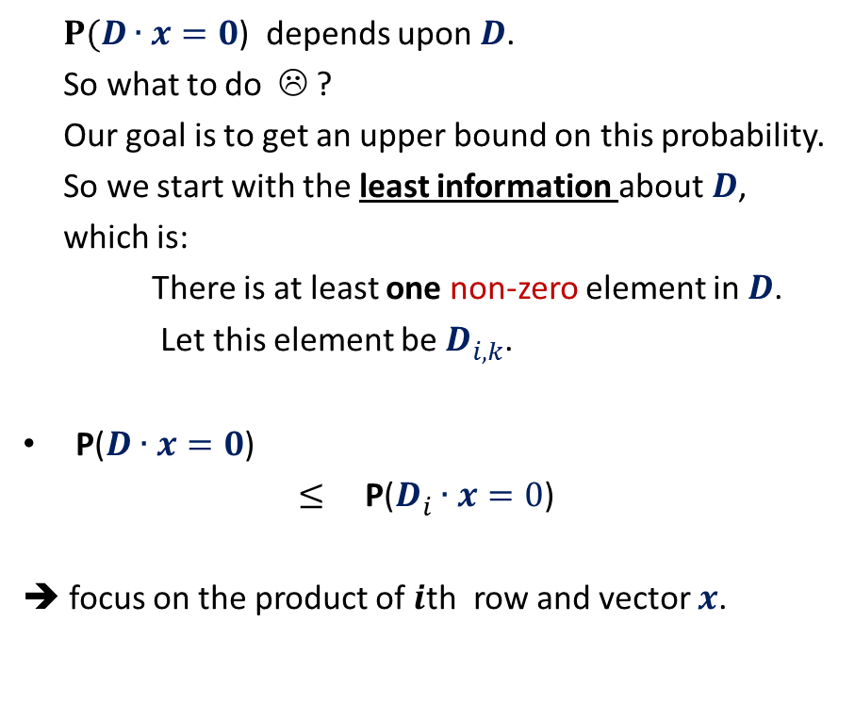

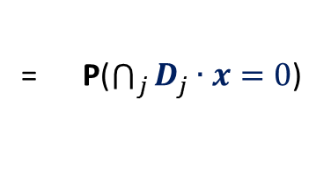

Frievald’s Algorithm (Analyzing error probability)
$$k$$
$P(D∙x=0$) depends upon $D$.
So what to do ☹ ?
Our goal is to get an upper bound on this probability.
So we start with the least information about $D$,
which is:
There is at least one non-zero element in $D$.
Let this element be $D_{i,k}^{}$.
P($D∙x=0$)
$≤$ P($D_{i}^{}∙x=0$)
➔ focus on the product of $i$th row and vector $x$.
$$1 2 … n$$
$$1$$
2
$$⋮$$
$$n$$
$$⨯$$
$$i$$
= P($\bigcap_{j}{D_{j}^{}∙x=0}$)
$$D$$
$$x$$
What is the relation between the two ?

Slide 16

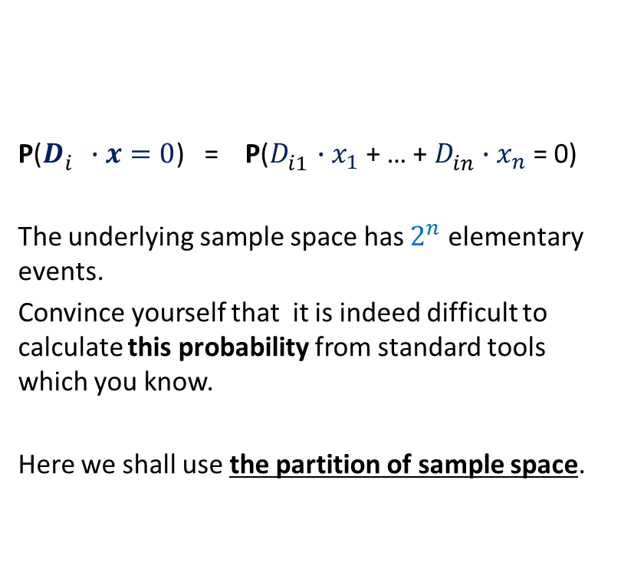
Frievald’s Algorithm (Analyzing error probability)
$$k$$
P($D_{i}^{}∙x=0$) = P($D_{i1}^{}$ $∙x_{1}$ + … + $D_{in}^{}$ $∙x_{n}$ = 0)
The underlying sample space has $2^{n}$ elementary events.
Convince yourself that it is indeed difficult to calculate this probability from standard tools which you know.
Here we shall use the partition of sample space.
$$1 2 … n$$
$$1$$
2
$$⋮$$
$$n$$
$$⨯$$
$$i$$
$$D$$
$$x$$

Slide 17

Probability tool: Partition of sample space
A set of events $A_{1}$,…, $A_{n}$defined over a probability space ($Ω$,P)
is said to induce a partition of $Ω$ if
$\bigcup_{l=1}^{n}{A_{l}}$ = $Ω$
$A_{i}\bigcap{A_{j}}$ =∅ for all$i≠j$
Theorem: (Partition theorem)
Given an event $ε$, we can express P($ε$) in terms of a given partition as:
P($ε$) = $\sum_{l}{\text{P}\text{(}ε}∩A_{l}$)
= $\sum_{l}{\text{P}\text{(}ε}\text{|}A_{l}$)∙ $\text{P}\text{(}A_{l}\text{)}$ using conditional probability
$$A_{2}$$
$$A_{3}$$
$$A_{4}$$
$$ε$$
$$A_{5}$$
$$A_{1}$$
Ω
$$A_{6}$$

Slide 18


Frievald’s Algorithm (Analyzing error probability)
$$ε$$
P( $D_{i1}^{}$ $∙x_{1}$ + … + $D_{in}^{}$ $∙x_{n}$ = 0 ) = ??
Question:
What can be the suitable partition of $Ω$?
➔ the partition defined by the values taken by all the r.v.’s excluding $x_{k}$.
…
Homework:
Make sincere attempt to complete the analysis.

Slide 19

Frievald’s Algorithm (Analyzing error probability)
Theorem:
Error probability of algorithm RandomProductVerify($A$,$B$,$C$) is at most $½$.
Question: How to reduce the error probability ?
Homework:
Make sincere attempt to answer the question.

Slide 20

Frievald’s Algorithm (final result)
Theorem: Given three $n$-by-$n$matrices $A$, $B$, and $C$,
there is a Randomized Monte Carlo algorithm which determines $C≟A⨯B$.
The running time is $O(n^{2}log n)$, and the error probability is less than $n^{−2}$.

Slide 21
Balls into BINS
Problem 1

Slide 22
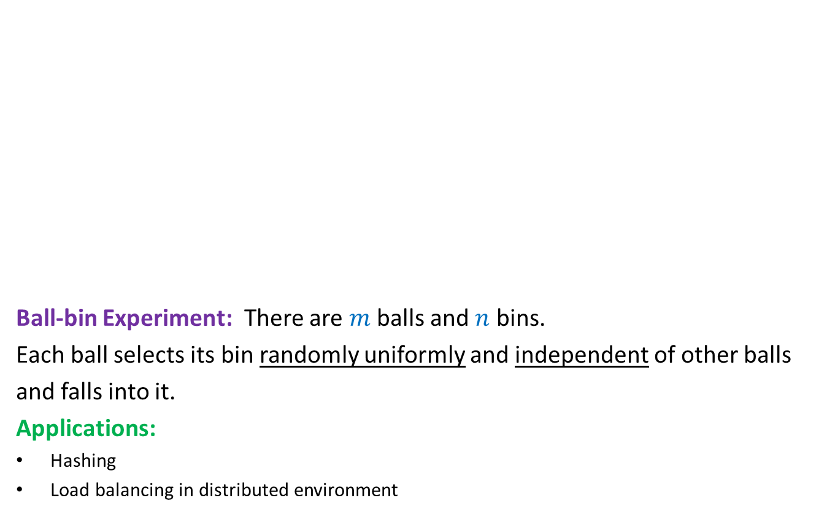
Balls into Bins
1 2 3 4 5 … $m−1$ $m$
Ball-bin Experiment: There are $m$ balls and $n$ bins.
Each ball selects its bin randomly uniformly and independent of other balls
and falls into it.
Applications:
Hashing
Load balancing in distributed environment
1 2 3 … $i$ … $n$

Slide 23
Balls into Bins
1 2 3 4 5 … $m−1 m$
Question : What is the probability that there is at least one empty bin ?
1 2 3 … $i$ … $n$

Slide 24
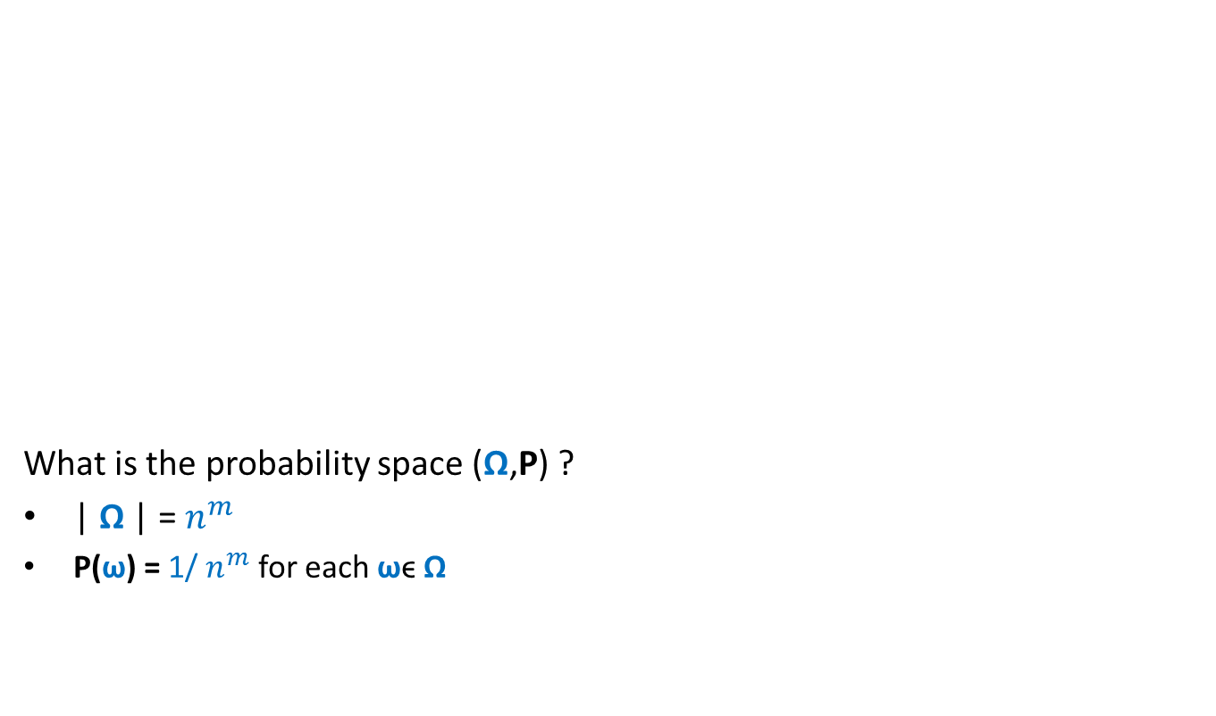
Balls into Bins
1 2 3 4 5 … $m−1 m$
What is the probability space (Ω,P) ?
| Ω | = $n^{m}$
P(ω) = 1/ $n^{m}$ for each ωϵ Ω
1 2 3 … $i$ … $n$

Slide 25
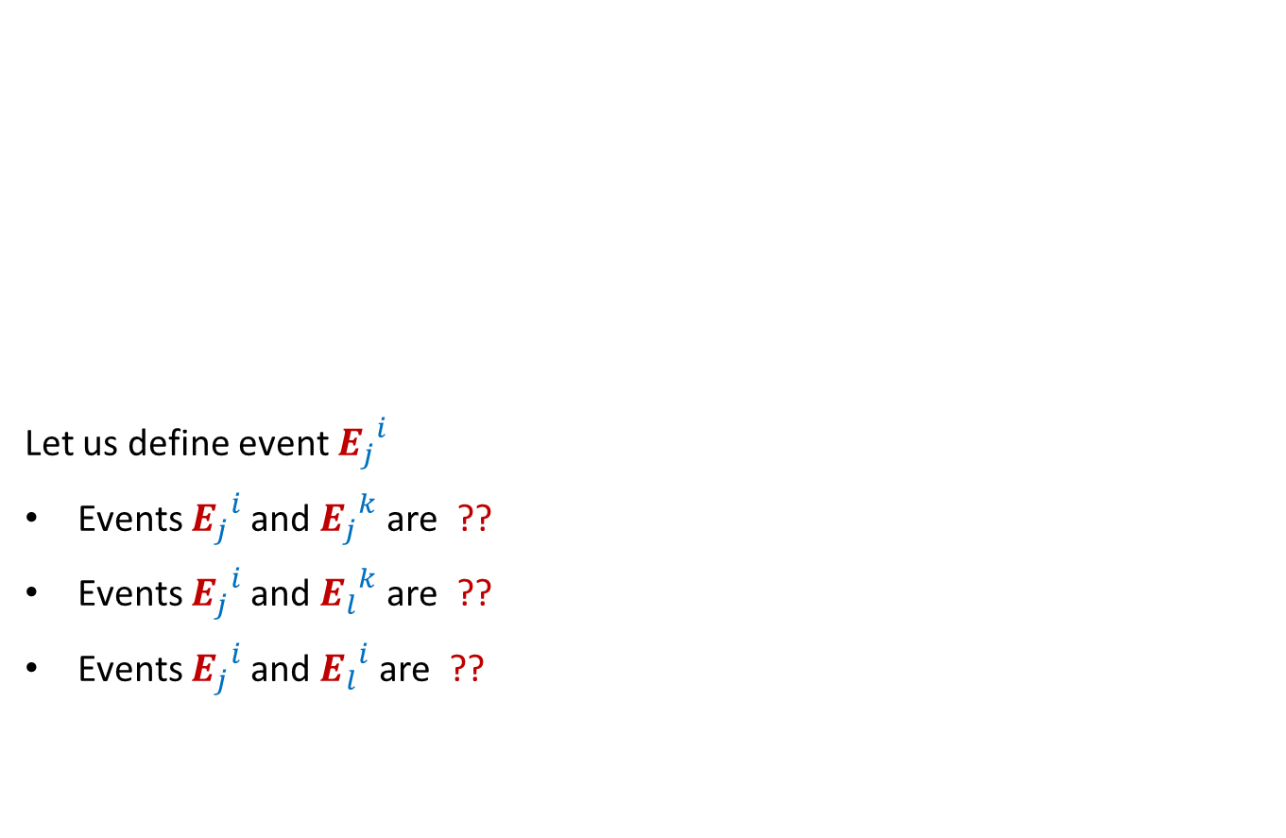

Balls into Bins
1 2 3 4 5 … $j$ … $m−1 m$
Let us define event ${E_{j}}_{}^{i}$
Events ${E_{j}}_{}^{i}$and ${E_{j}}_{}^{k}$are ??
Events ${E_{j}}_{}^{i}$and ${E_{l}}_{}^{k}$are ??
Events ${E_{j}}_{}^{i}$and ${E_{l}}_{}^{i}$are ??
1 2 3 … $i$ … $n$
: $j$th ball falls into $i$th bin.
disjoint
Independent
Independent

Slide 26


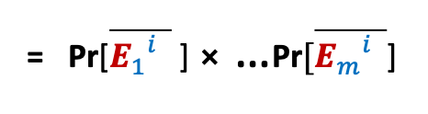
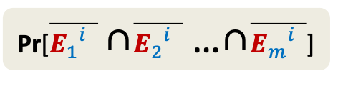

Balls into Bins
1 2 3 4 5 … $j$ … $m−1 m$
${E_{j}}_{}^{i}$ : $j$th ball enters $i$th bin.
Pr[${E_{j}}_{}^{i}$] = ??
Pr[$\overline{{E_{j}}_{}^{i}}$] = ??
Pr[$i$th bin is empty] = ??
=${(1−\frac{1}{n} )}^{m}$
1 2 3 … $i$ … $n$
$$\frac{1}{n}$$
$$1−\frac{1}{n}$$
Pr[$\overline{{E_{1}}_{}^{i}}$ ∩$\overline{{E_{2}}_{}^{i}}$ …∩$\overline{{E_{m}}_{}^{i}}$]
= Pr[$\overline{{E_{1}}_{}^{i}}$ ] ⨯ …$\text{Pr}[\overline{{E_{m}}_{}^{i}}$]

Slide 27



Balls into Bins
1 2 3 4 5 … $j$ … $m−1 m$
Pr[$i$th bin is empty] = ${(1−\frac{1}{n} )}^{m}$
Pr[$i$th and $k$th bin are empty] = ??
Pr[a specified set of $l$bins are empty] = ??
1 2 3 … $i$ … $n$
$${(1−\frac{2}{n} )}^{m}$$
$${(1−\frac{l}{n} )}^{m}$$

Slide 28
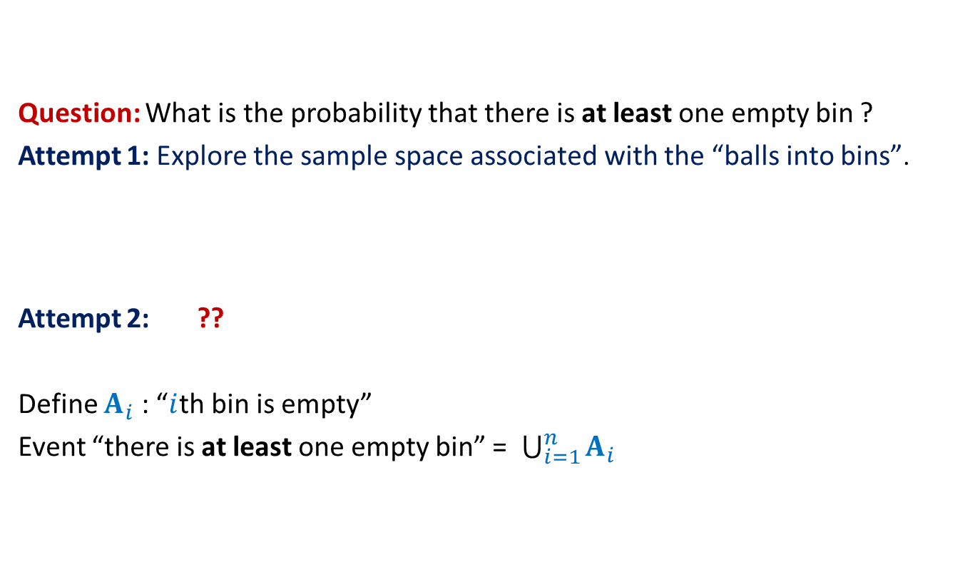
Balls into Bins
Question: What is the probability that there is at least one empty bin ?
Attempt 1: Explore the sample space associated with the “balls into bins”.
Attempt 2: ??
Define $A_{i}$ : “$i$th bin is empty”
Event “there is at least one empty bin” = $\bigcup_{i=1}^{n}{A_{i}}$
Express the event as union of some events …
Homework:
Make sincere attempt to solve it or at least feel the difficulty.

Slide 29
Randomized Quick sort
Problem 2

Slide 30

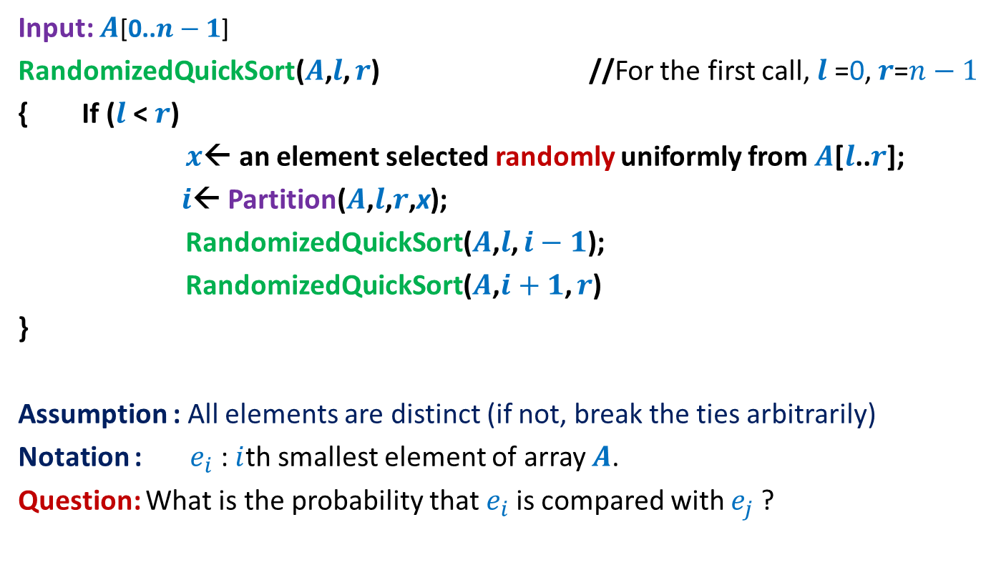
Randomized Quick Sort
Input: $A$[0..$n−1$]
RandomizedQuickSort($A$,$l$, $r$) //For the first call, $l$ =0, $r$=$n−1$
{ If ($l$ < $r$)
$x$← an element selected randomly uniformly from $A$[$l$..$r$];
$i$← Partition($A$,$l$,$r$,x);
RandomizedQuickSort($A$,$l$, $i−1$);
RandomizedQuickSort($A$,$i+1$, $r$)
}
Assumption : All elements are distinct (if not, break the ties arbitrarily)
Notation : $e_{i}$ : $i$th smallest element of array $A$.
Question: What is the probability that $e_{i}$is compared with $e_{j}$?
Recall that the execution of RandomizedQuickSort is totally immune to the permutation of $A$.

Slide 31
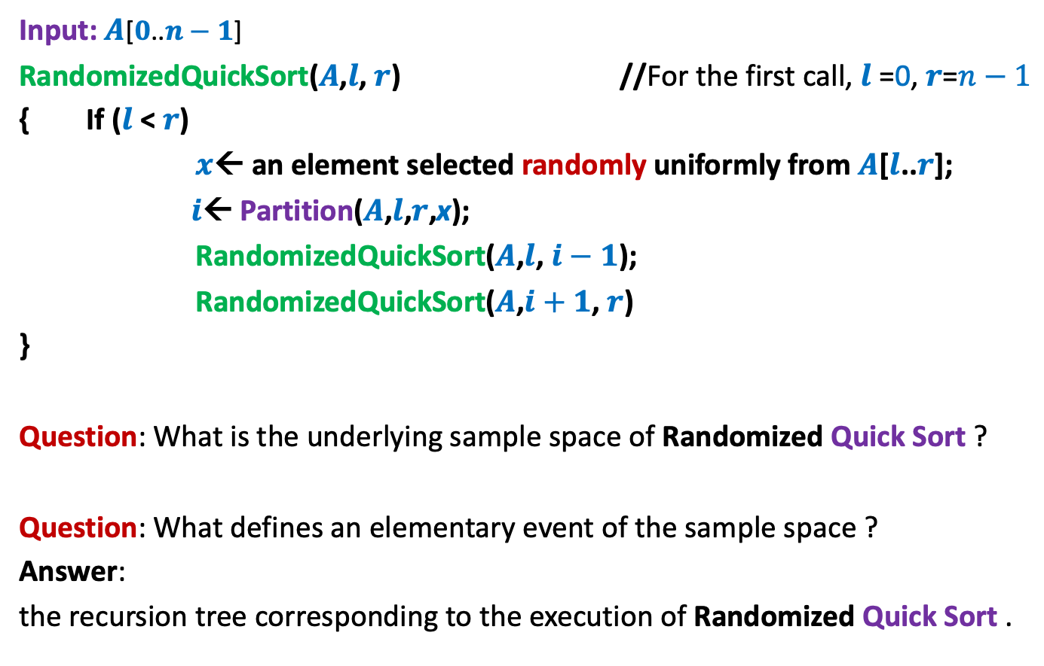
Randomized Quick Sort
Input: $A$[$0$..$n−1$]
RandomizedQuickSort($A$,$l$, $r$) //For the first call, $l$ =0, $r$=$n−1$
{ If ($l$ < $r$)
$x$← an element selected randomly uniformly from $A$[$l$..$r$];
$i$← Partition($A$,$l$,$r$,x);
RandomizedQuickSort($A$,$l$, $i−1$);
RandomizedQuickSort($A$,$i+1$, $r$)
}
Question: What is the underlying sample space of Randomized Quick Sort ?
Question: What defines an elementary event of the sample space ?
Answer:
the recursion tree corresponding to the execution of Randomized Quick Sort .

Slide 32



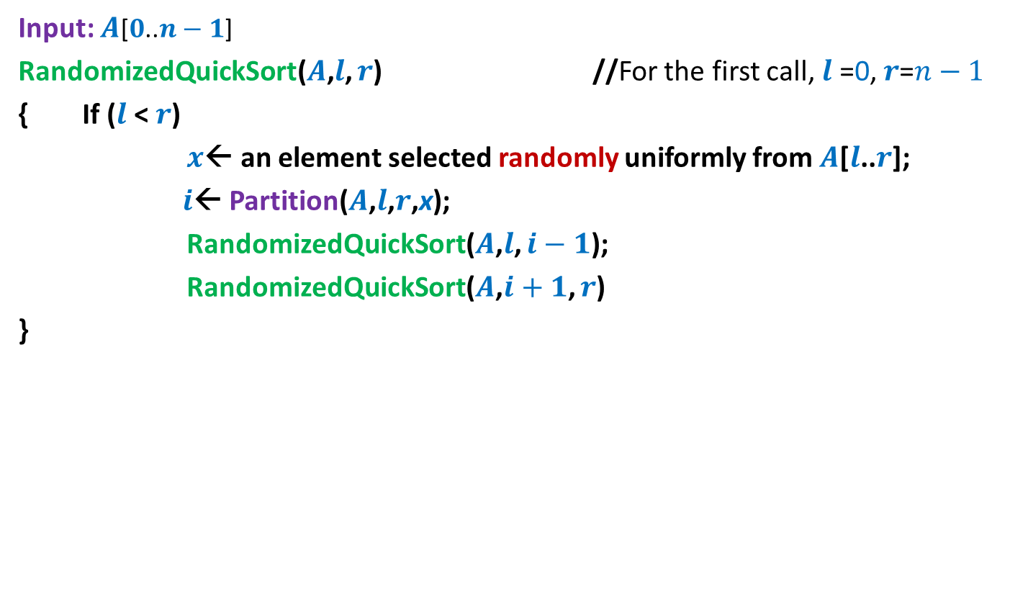

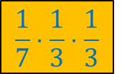




Randomized Quick Sort
Input: $A$[$0$..$n−1$]
RandomizedQuickSort($A$,$l$, $r$) //For the first call, $l$ =0, $r$=$n−1$
{ If ($l$ < $r$)
$x$← an element selected randomly uniformly from $A$[$l$..$r$];
$i$← Partition($A$,$l$,$r$,x);
RandomizedQuickSort($A$,$l$, $i−1$);
RandomizedQuickSort($A$,$i+1$, $r$)
}
$$n=7$$
$$\frac{1}{7}⋅\frac{1}{3}⋅\frac{1}{3}$$
$$e_{4}$$
$$e_{2}$$
$$e_{6}$$
$$e_{1}$$
$$e_{3}$$
$$e_{5}$$
$$e_{7}$$

Slide 33




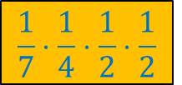




Randomized Quick Sort
Input: $A$[$0$..$n−1$]
RandomizedQuickSort($A$,$l$, $r$) //For the first call, $l$ =0, $r$=$n−1$
{ If ($l$ < $r$)
$x$← an element selected randomly uniformly from $A$[$l$..$r$];
$i$← Partition($A$,$l$,$r$,x);
RandomizedQuickSort($A$,$l$, $i−1$);
RandomizedQuickSort($A$,$i+1$, $r$)
}
$$n=7$$
$$e_{5}$$
$$\frac{1}{7}⋅\frac{1}{4}⋅\frac{1}{2}⋅\frac{1}{2}$$
$$e_{2}$$
$$e_{6}$$
$$e_{1}$$
$$e_{4}$$
$$e_{7}$$
$$e_{3}$$

Slide 34
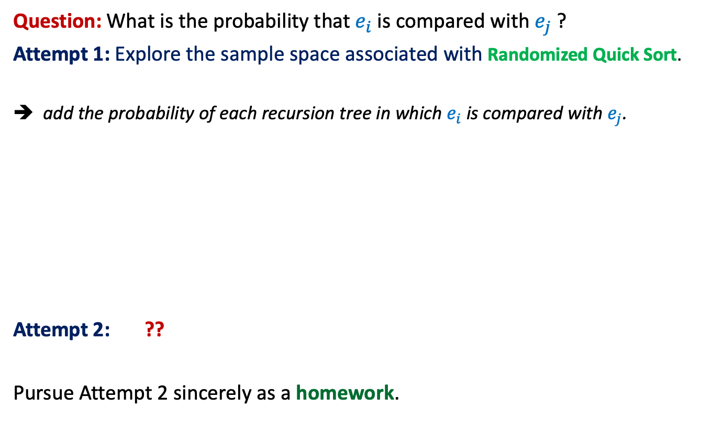
Randomized Quick Sort
Question: What is the probability that $e_{i}$is compared with $e_{j}$?
Attempt 1: Explore the sample space associated with Randomized Quick Sort.
➔ add the probability of each recursion tree in which $e_{i}$is compared with $e_{j}$.
Attempt 2: ??
Pursue Attempt 2 sincerely as a homework.
Not a feasible way to calculate the probability
View the execution of RandomizedQuickSort from perspective of $e_{i}$ and $e_{j}$

